Slide 1

Let’s start with Allah Yaar
Bs in Computer Science

Slide 2
ICT (Information and Communication Technologies)
Information and Communication Technologies
Define:
Can be broadly defined as the means of creation, storage, management and dissemination of information by electronic means.
Those technologies that enable the handling of information and facilitate different forms of communication.

Slide 3
Components of the CPU
The Central Processing Unit (CPU) is often referred to as the "brain" of a computer. It is a critical component responsible for executing instructions from programs and performing the basic arithmetic, logic, control, and input/output (I/O) operations specified by those instructions.
Components of the CPU
Arithmetic Logic Unit (ALU)
Control Unit (CU)
Registers
Cache

Slide 4
CPU Performance Metrics
Clock Speed (GHz) (Indicates how many cycles per second the CPU can perform. Higher clock speeds generally mean faster processing.)
Cores: Modern CPUs have multiple cores, allowing them to perform multiple tasks simultaneously (parallel processing).
Cache Size: Larger caches can store more data and instructions, reducing the time the CPU spends accessing main memory.

Slide 5
The Role of the CPU in Processing Instructions
The CPU processes instructions through a systematic cycle often referred to as the Fetch-Decode-Execute cycle.
Fetch (The CPU retrieves (fetches) the next instruction from the computer's main memory (RAM) using the Program Counter (PC), which keeps track of the execution sequence.)
Decode (The Control Unit deciphers the fetched instruction to understand what action is required. This involves interpreting the opcode (operation code) and identifying the operands (data or addresses involved).)

Slide 6
The Role of the CPU in Processing Instructions
Execute (The CPU carries out the instruction by performing the necessary operations using the ALU, manipulating data, or interacting with other hardware components)
Store (If the instruction involves data manipulation, the result is stored back in memory or in a register for future use)
Update Program Counter (The PC is updated to point to the next instruction, and the cycle repeats.)
This continuous cycle allows the CPU to perform complex computations and run applications efficiently, ultimately producing the desired output based on the input and instructions provided.

Slide 7
Internal Memory
Internal memory refers to the components within the CPU that store data and instructions temporarily during processing.
Types of Internal Memory:
Registers (As mentioned earlier, registers are small storage locations within the CPU used to hold data temporarily during instruction execution. They are the fastest type of memory available to the CPU)
Cache Memory (Positioned between the CPU and the main memory (RAM), cache memory stores frequently accessed data and instructions to reduce latency and improve processing speed.)

Slide 8
Importance of Internal Memory
Speed: Provides rapid data access compared to external storage.
Efficiency: Minimizes the time the CPU spends waiting for data retrieval.
Performance: Enhances overall system performance by supporting multitasking and complex computations.

Slide 9
ROM (Read-Only Memory)
Read-Only Memory (ROM) is a type of non-volatile memory used to store firmware and permanent instructions essential for booting and operating hardware devices.
Characteristics of ROM
Non-Volatile: Retains data even when the power is turned off.
Read-Only: Data is typically written during manufacturing and cannot be modified easily. Some types, like EEPROM and Flash ROM, allow limited rewriting.
Stability: Provides a stable and secure storage medium for critical instructions.
Speed: Slower write speeds compared to RAM but optimized for reading data.

Slide 10
Uses of ROM
Firmware Storage: Contains essential instructions for hardware initialization and boot processes.
Embedded Systems: Used in devices like calculators, gaming consoles, and appliances for storing fixed programs.

Slide 11
RAM (Random Access Memory)
Random Access Memory (RAM) is a type of volatile memory that serves as the computer's main memory, providing space for the operating system, applications, and data currently in use.
Characteristics of RAM
Volatile: Loses all stored information when the power is turned off.
Random Access: Allows data to be read or written in any order, enabling quick access to any memory location.
Speed: Much faster than secondary storage devices like HDDs or SSDs.
Capacity: Typically larger in capacity compared to cache but smaller than long-term storage solutions.

Slide 12
Types of RAM
DRAM (Dynamic RAM) (Needs to be refreshed thousands of times per second; commonly used as the main system memory.)
SRAM (Static RAM) (Faster and more reliable than DRAM but more expensive; often used for cache memory.)

Slide 13
Uses of RAM
Running Applications: Provides the necessary space for programs to execute and for data to be processed.
Multitasking: Allows multiple applications to run simultaneously by allocating separate memory spaces.
System Performance: Adequate RAM ensures smooth and efficient system operation, minimizing delays and enhancing responsiveness.

Slide 14
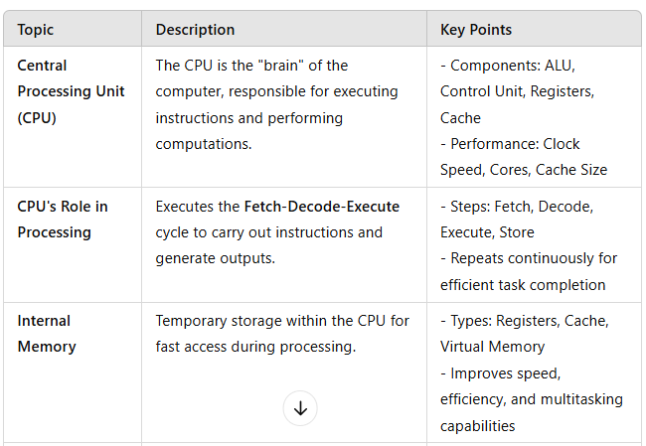
Summary Table

Slide 15
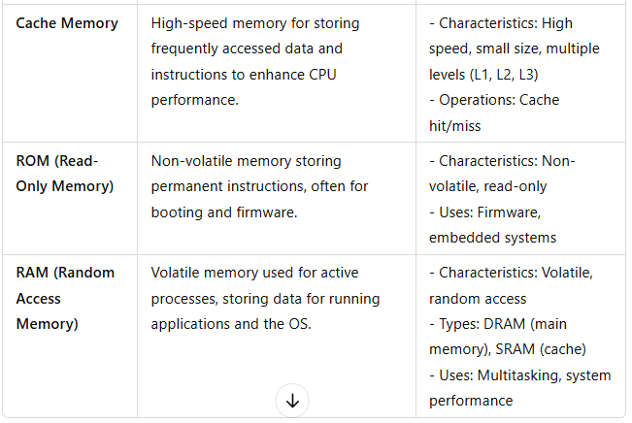
Summary Table

